Slide 1
RSA Algorithm
Dr.A.Neela Madheswari,
Professor,
Mahendra Engineering College

Slide 2
Public key encryption
Plain text
Encryption algorithm
Public key
Private key
Decryption algorithm
Cipher text

Slide 3
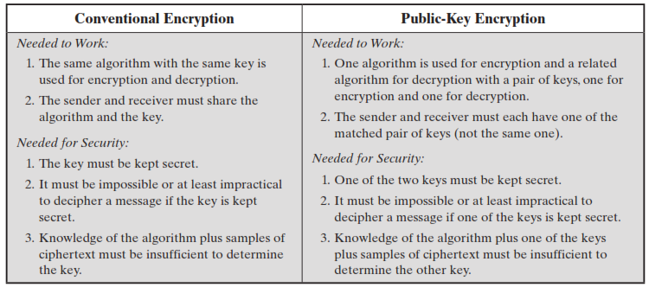

Slide 4
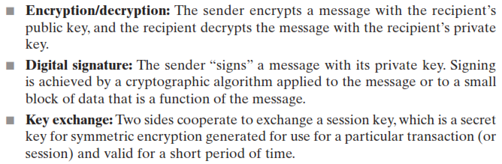
Classification of public key crypto systems

Slide 5
RSA
Asymmetric cryptography algorithm proposed for public key cryptography by Ron Rivest, Adi Shamir, Len Adleman at MIT in 1978
RSA makes use of an expression with exponentials
Plain text is encrypted in blocks, each block having binary value less than some number n
Encryption and Decryption:
C = Me mod n, M = C^{d} mod n = (Me)^{d} mod n = M^{ed} mod n
For encryption, we have to use recipient’s public key. Here Public key is given as PU = {e, n}
For decryption, we have to use recipient’s private key. Here private key is given as PR = {d, n}
Both sender and receiver must know the value of n

Slide 6
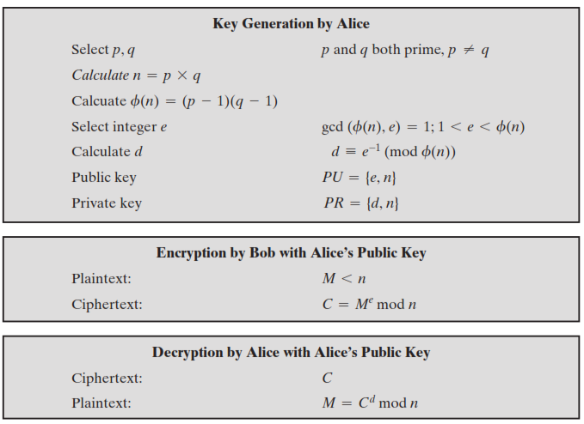
p and q-prime
p = 17
q = 11
n = pxq = 17x11=187
ɸ(n) = (p-1) x (q-1) = 16x10
= 160
e-prime, <ɸ(n)
e = 7
d,de=1 (mod 160), d<160
23x7=161,
Hence, d=23
PU = {e,n}={7,187}
PR = {d,n}={23,187}
Encryption:
M = 88, PU = {7, 187}
C = Me mod n = 88⁷ mod 187 = 11
Decryption:
C = 11, PR = {23, 187}
P = C^{d} mod n = 11²³ mod 187 = 88

Slide 7
RSA Algorithm
Aim:
To write a java program to implement RSA algorithm
Algorithm:
Enter the values of p and q
Enter the message
Calculate n and phi using the formula n = p x q, phi = (p-1) x (q-1)
Select e such that e should be prime and e < phi
Calculate d such that de = 1 mod phi
Public key = {e, n} and Private key = {d, n}
Calculate Cipher text C = Me mod n
Calculate Plain text from Cipher text, M = C^{d} mod n
Display public key, private key
Display the plain text and cipher text

Slide 8
Coding
import java.util.*;
import java.math.*;
class RSA
{
public static void main(String args[])
{
Scanner sc=new Scanner(System.in);
int p,q,n,z,d=0,e,i;
System.out.println("Enter the message: ");
int msg=sc.nextInt();
double c;
BigInteger msgback;
System.out.println("Enter 1st prime number p");
p=sc.nextInt();
System.out.println("Enter 2nd prime number q");

Slide 9
Coding
q=sc.nextInt();
n=p*q;
z=(p-1)*(q-1);
System.out.println("the value of z = "+z);
for(e=2;e<z;e++)
{
if(gcd(e,z)==1)
{
break;
}
}
System.out.println("the value of e = "+e);

Slide 10
Coding
for(i=0;i<=9;i++)
{
int x=1+(i*z);
if(x%e==0)
{
d=x/e;
break;
}
}
System.out.println("the value of d = "+d);
c=(Math.pow(msg,e))%n;
System.out.println("Encrypted message is : -");
System.out.println(c);

Slide 11
Coding
BigInteger N = BigInteger.valueOf(n);
BigInteger C = BigDecimal.valueOf(c).toBigInteger();
msgback = (C.pow(d)).mod(N);
System.out.println("Decrypted message is : -");
System.out.println(msgback);
}
static int gcd(int e, int z)
{
if(e==0)
return z;
else
return gcd(z%e,e);
}
}

Slide 12
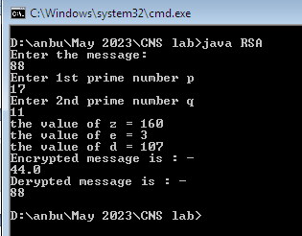
Output

